Slide 1

Unit 3

Slide 2


To understand the passages about three pairs of good friends’ similarities and differences
To learn to compare you and your friends, using comparative forms
To learn some new words and useful expressions
To understand the attitudes and views of Chinese and foreign teenagers towards friendship

Slide 3


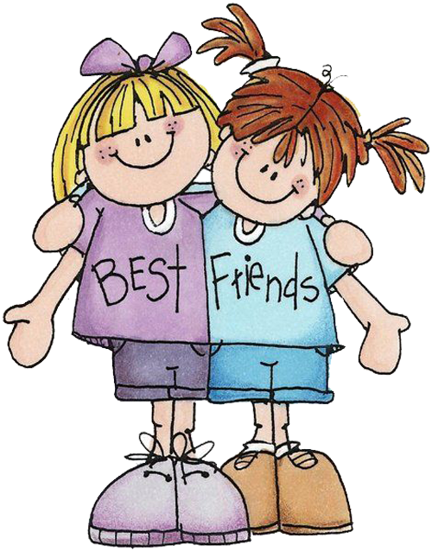
What makes a good friend?
truly cares about me
makes me laugh
a good listener
have the same interests
...

Slide 4


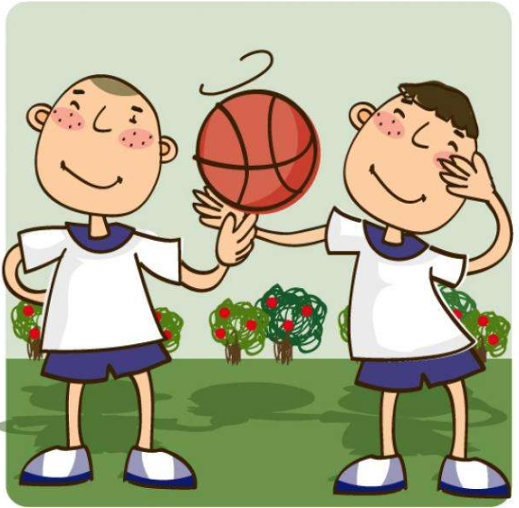
They are good friends.
They are both tall.
They both like sports.
Liu Lei’s hair is longer.
Li Ming is quieter.
Liu Lei talks more, and he is more outgoing.
Li Ming Liu Lei

Slide 5



Write the comparative forms of the following adjectives. Then use them to write five sentences about you and your friends.
funnier
popular ____________ funny ________
hard-working ___________________
quiet ________ serious _____________
friendly _________ smart _________
outgoing _____________ shy _______
more popular
more hard-working
adj. 严肃的；稳重的
quieter
more serious
friendlier
smarter
more outgoing
shyer
e.g. My friend David is more hard-working than me, but I am funnier than him.

Slide 6

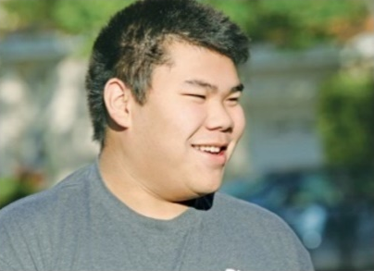
Suppose you’re Huang Lei, describe your friend
who is different from you.
Huang Lei
adj. 必需的；必要的
It's not necessary to be the same. My best friend Larry is quite different from me. He is taller and more outgoing than me. We both like sports, but he plays tennis better, so he always wins. However, Larry often helps to bring out the best in me. So I'm getting better at tennis. Larry is much less hard-working, though. I always get better grades than he does, so maybe I should help him more.
n. 成绩等级；评分等级
使显现；使表现出
modal v. 应该

Slide 7
Describe your friend who is different from you.
My best friend Larry is quite different from me. He is taller and more outgoing than me. We both like sports, but he plays tennis better, so he always wins. However, Larry often helps to bring out the best in me. So I'm getting better at tennis. Larry is much less hard-working, though. I always get better grades than he does, so maybe I should help him more.

Slide 8

















Retell the passage according to the mind map.
Jeff Green
Huang Lei
not necessary to be the same
A good friend is like a
is quite different from
quieter and more serious
study harder
getting better
not easy
quiet
Yuan Li
taller and more outgoing
Mary Smith
win
bring out the best in me
You don't need a lot of them
as long as they're good.
Larry
much less hard-working
A true friend reaches for your hand and touches your heart.
Carol
kind and funny

Slide 9

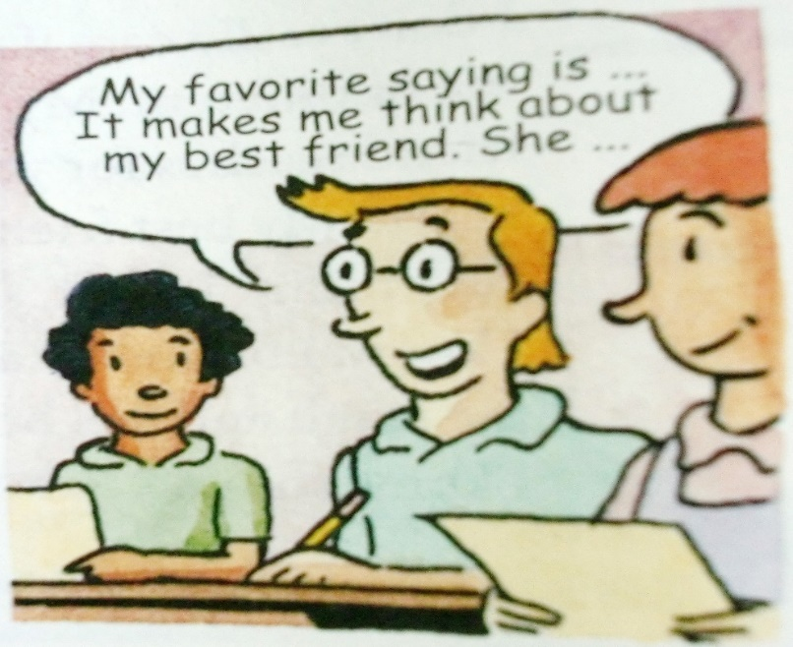
Which saying about friends is your favorite? Which friend do you think about when you read this saying? Why? Tell your partner about it.
1. A good friend is like a mirror.
2. Friends are like books — you don’t need a lot of them as long as they’re good.
3. My best friend helps to bring out the best in me.
4. A true friend reaches for your hand and touches your heart.

Slide 10

Unit 3
I’m more outgoing than my sister.

Slide 11



Slide 12


Lead in
Peter is Molly’s best friend. In some ways, Molly is the same as Peter. For example, they are both pretty outgoing. In more ways, Molly is different from Peter. Molly studies harder than Peter. Peter plays baseball better and speaks more loudly than Molly. But Peter likes to do the same things as Molly. That’s important for Molly, so they still become good friends.

Slide 13

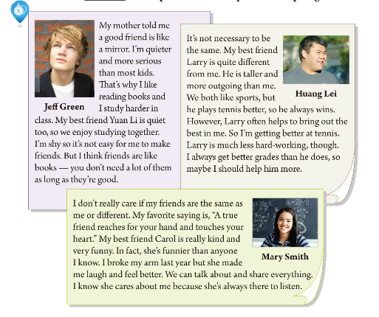
Do you think friends should be the same or different?
Here are some ideas about friends from Jeff Green,
Huang Lei and Mary Smith.

Slide 14


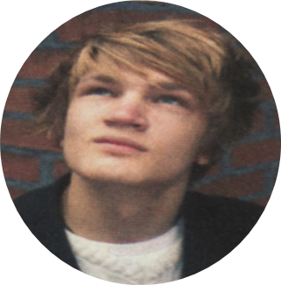
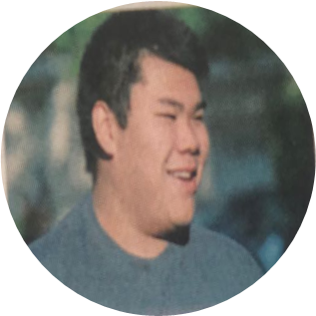
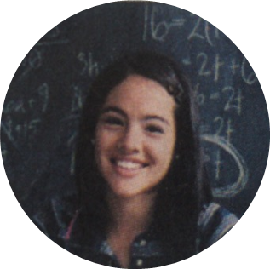
Listen to the three passages and find his/her best friend.
Underline the comparative(比较级) words and phrases in the passages.
Jeff Green
Huang Lei
Mary Smith
Larry
Carol
Yuan Li

Slide 15
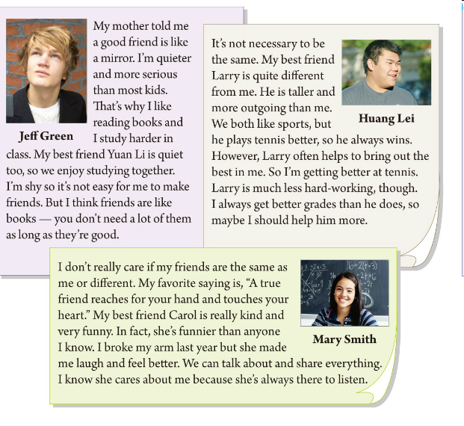
The comparative words and phrases

Slide 17

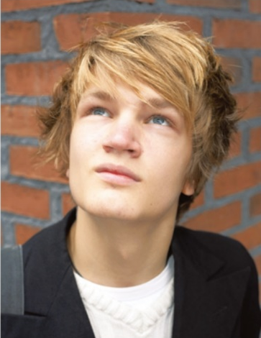
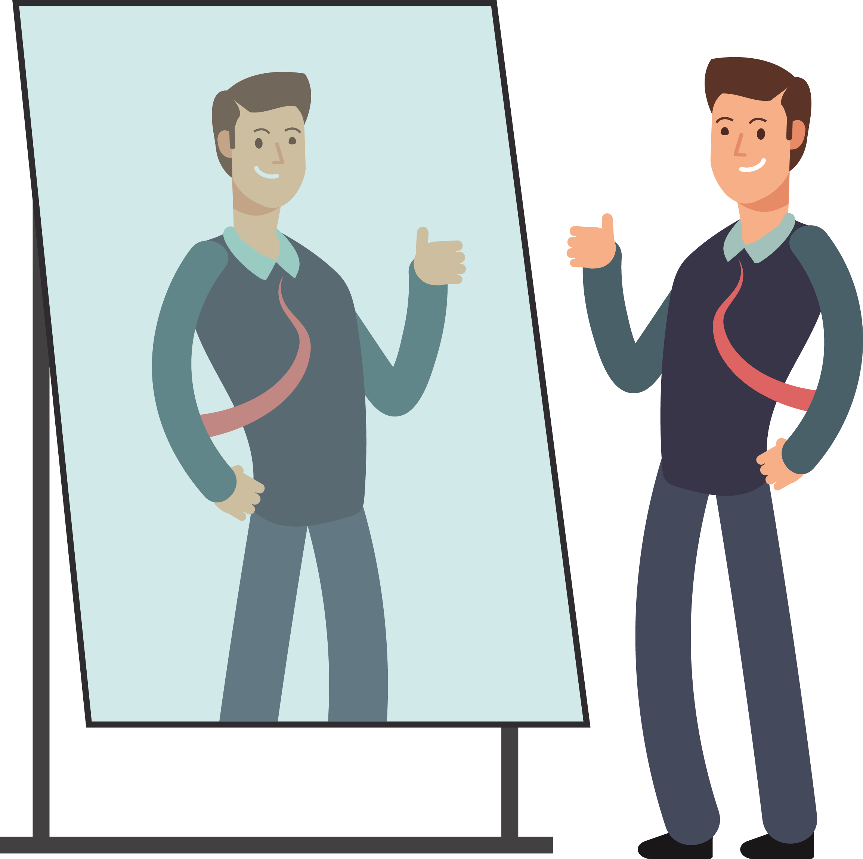
Read the first passage and answer the question.
1.What's Jeff's opinion(看法) about a friend?2
A good friend is like a mirror(saying).
Friends are like books―you don't need a lot of them as long as they're good(saying).
n. 镜子
n. 谚语；
格言；
警句
只要
2.Does Jeff have a lot of friends? Why or why not?
No, he doesn't.
Because he is shy. It's not easy for him to make friends.

Slide 18

Are the following statements true or false?
F
1. Jeff is less serious than most kids.
2. Jeff and Yuan Li are both quiet.
3. Jeff thinks it is easy for him to make friends.
T
F

Slide 19
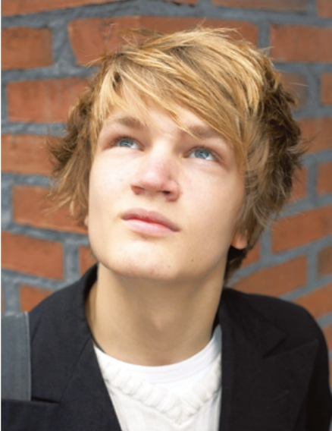
My mother told me a good friend is like a
mirror. I'm quieter and more serious than most
kids. That's why I like reading books and I
study harder in class. My best friend Yuan Li
is quiet too, so we enjoy studying together.
I'm shy so it's not easy for me to make friends.
But I think friends are like books—you don't
need a lot of them as long as they're good.
n. 小孩
Jeff Green
In Jeff’s opinion, should friends be the same or different?
Suppose you’re Jeff, describe your friend who is similar to you.

Slide 20
Describe your friend who is similar to you.
As a saying goes, a good friend is like a mirror. My best friend Yuan Li is the same as me. She’s as quiet as me. We both like reading books and study hard.

Slide 21
Which saying about friends is your favorite?
Let’s read!
1. A good friend is like a mirror.
2. Friends are like books — you don’t need a lot of them as long as they’re good.
Friends are like books —every time I spend time with them, I learn something new from them.
3. My best friend helps to bring out the best in me.
4. A true friend reaches for your hand and touches your heart.

Slide 22
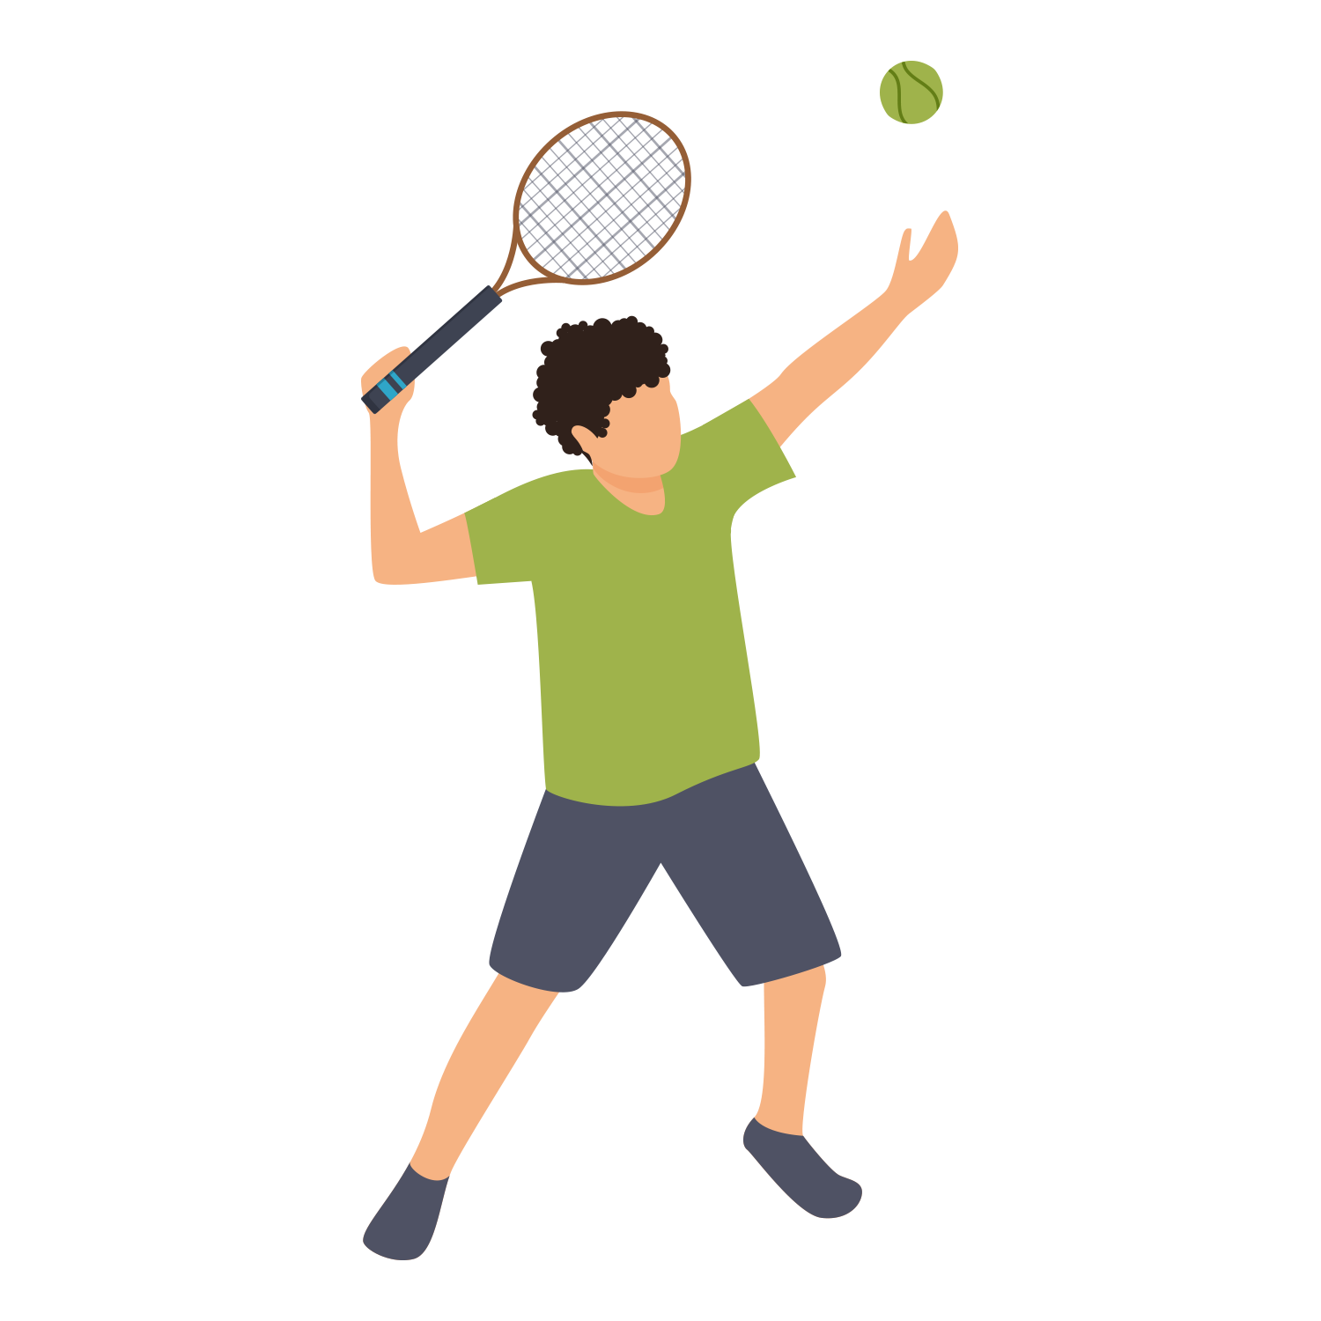

Read the second passage and answer the question.
What's Huang Lei's opinion about a friend?3
It's not necessary that friends are the same.
A friend often helps to bring out the best in me(saying).
A friend should help each other.(Huang Lei always gets better grades than Larry does, so he wants to help Larry more.)

Slide 23
Are the following statements true or false?
4. Huang Lei is taller than Larry.
5. Huang Lei isn’t as/so good at tennis as Larry.
6. Larry works harder than Huang Lei.
F
T
F

Slide 24
It's not necessary that friends are the same.
Huang Lei
adj. 必需的；必要的
It's not necessary to be the same. My best friend Larry is quite different from me. He is taller and more outgoing than me. We both like sports, but he plays tennis better, so he always wins. However, Larry often helps to bring out the best in me. So I'm getting better at tennis. Larry is much less hard-working, though. I always get better grades than he does, so maybe I should help him more.
n. 成绩等级；评分等级
使显现；使表现出
modal v. 应该

Slide 25

Read the third passage and answer the question.
What's Mary Smith's opinion about a friend?
She doesn't really care if her friends are the same as her or different.
A true friend reaches for your hand and touches your heart(saying).
v. 感动；触摸
v. 伸手；
到达；
n. 内心；心脏

Slide 26
Are the following statements true or false?
7. Mary thinks her friends should be the same as her.
8. Carol broke her arm last year and Mary made her feel better.
F
F

Slide 27
I don't really care if my friends are the same as me or different. My favourite saying is,” A true friend reaches for your hand and touches your heart.” My best friend Carol is really kind and very funny. In fact, she's funnier than anyone I know. I broke my arm last year but she made me laugh and feel better. We can talk about and share everything. I know she cares about me because she's always there to listen.
Mary Smith
n. 事实
in fact
确切地说；事实上；实际上
v. 原形break
(使)破；裂；损坏
n. 手臂；上肢
v. 分享；共享；共用；分摊

Slide 28

How do you and your friends compare with the people in the article? Write five sentences.
I’m different from Jeff because I’m louder than the other kids in my class.
My best friend is similar to Larry because she’s less hard-working than me.
A be different from B because …
A be similar to B because …
A be the same as B because …

Slide 29


Slide 30
1. I’m similar to Jeff because I like reading books and work harder in class.
2. My friend is similar to Carol because she always makes me laugh.
3. I’m different from Huang Lei because I think my best friends should be the same as me.
4. My friend is similar to Yuan Li because she is quiet and likes studying.
5. I’m similar to Carol because I’m funnier than any other kids and I make my friends laugh.

Slide 31
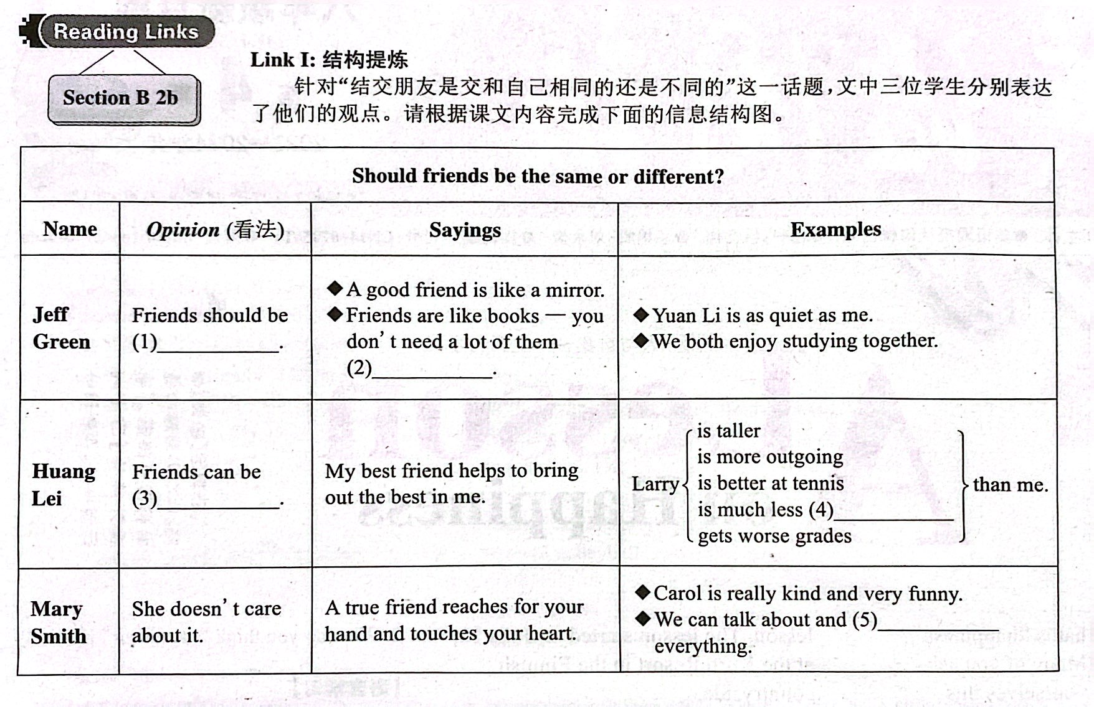

Slide 32

More sayings about friends
A friend in need is a friend indeed.
患难见真情。
A friend is easier lost than found.
得朋友难, 失朋友易。
A friend is never known till a man has need.
需要之时方知友。
A friend without faults will never be found.
没有十全十美的朋友。

Slide 33
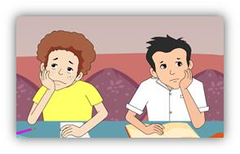
Friendship is like money, easier made than kept.
友谊如金钱一般，容易得到却不易保持。
What is a friend? A single soul dwelling in two bodies.
朋友是什么? 两幅躯壳拥有同一个灵魂。
Which saying do you like best? Why?

Slide 34
What's his/her opinion about a friend?
Friends are like books–you don't need a lot of them as long as they're good.
A friend often helps to bring out the best in me.
A good friend is like a mirror.
A true friend reaches for your hand and touches your heart.

Slide 35
Complete the table according to the passage.
 | Similarities (相似之处) | Differences
Jeff Green and Yuan Li | ◆They are both _____. ◆They both enjoy studying together. | ◆Jeff is more serious. ◆Jeff _______ _______ in class.
quiet
studies
harder

Slide 36
 | Similarities (相似之处) | Differences
Huang Lei and Larry | They both like_______. | ◆Larry is _______ and more outgoing. ◆Larry ________ ________ better. ◆Larry is much less hard-working.
Mary Smith and Carol |  | Carol is funnier.
taller
plays
tennis
sports

Slide 37
Are the following statements true or false?
F
1. Jeff is less serious than most kids.
2. Jeff and Yuan Li are both quiet.
3. Jeff thinks it is easy for him to make friends.
4. Huang Lei is taller than Larry.
5. Huang Lei isn’t as good at tennis as Larry.
6. Larry works harder than Huang Lei.
7. Mary thinks her friends should be the same as her.
8. Carol broke her arm last year and Mary made her feel better.
T
F
F
T
F
F
F

Slide 38

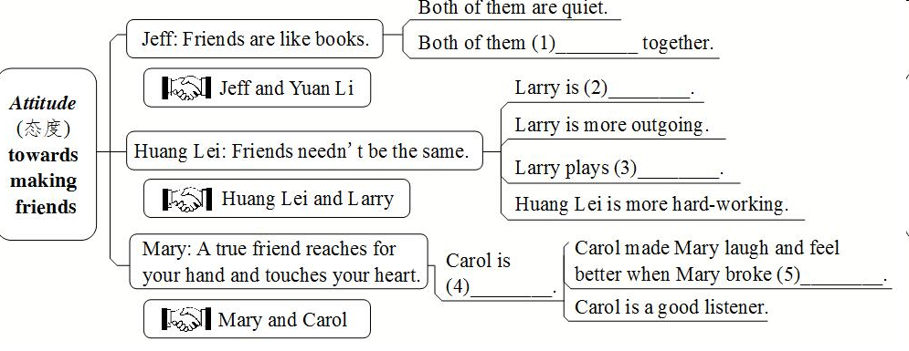
Close your books and fill in the blanks.
enjoy studying
taller
tennis better
her arm
kind and
funny

Slide 39

Try to retell their opinions.
What’s Jeff Green’s opinion? What are the similarities and differences between him and his friend?
What’s Huang Lei’s opinion? What are the similarities and differences between him and his friend?
What’s Mary Smith’s opinion? What are the similarities and differences between her and her friend?

Slide 40





Retell the passage according to the mind map.
Jeff Green
Huang Lei
not necessary to be the same
A good friend is like a
is quite different from
quieter and more serious
study harder
getting better
win
taller and more outgoing
not easy
quiet
Yuan Li
brings out
Larry
much less hard-working
You don't need a lot of them
as long as they're good.
Mary Smith
A true friend reaches for your hand and touches your heart.
Carol
kind and funny

Slide 41


只要；既然
与……不同；与……有差异
使显现；使表现出
取得好成绩
确切地说；事实上；实际上
摔断了某人的胳膊
与……相像的、类似的
帮忙做某事
as long as
be different from
bring out
get good grades
in fact
break one's arm
be similar to
help (to) do sth.

Slide 42
A good friend is like a mirror.
好朋友就像一面镜子。
Friends are like books — you don’t need a lot of them as long as they’re good.
朋友如书，不在多而贵在好。
A true friend reaches for your hand and touches your heart.
一个真正的朋友是在需要时给你帮助，使你感动。
She’s always there to listen.
她随时都能够听我倾诉。

Slide 43


Ⅰ. 根据句意及所给汉语提示，写出所缺单词。
1.“A friend in need is a friend indeed.” This is one of my favorite _______(谚语).
2. The little boy dislikes _______(分享) his model planes with others.
3. Rick _______(摔断) his arm when he went skating yesterday.
4. The police ______________________(到达) here just now.
sayings
sharing
broke
reached / arrived / got

Slide 44
5. Remember to keep both _______(手) clean and wash them before eating.
6. Henry’s story _________________(感动) me deeply (深深地) and I wanted to do something to help him.
7. Follow your _______(内心) and go for it. Then you will enjoy your life.
hands
touched / moved
heart

Slide 45
Ⅱ. 根据汉语意思，完成英语句子，每空一词。
1. 他总能激发出他学生的潜能。
He can always ______ ______ ______ ______ in his students.
2. 她看上去很严肃，但实际上不是。
She seems serious, but _______ _______ she isn’t.
3. 今晚你可以出去，只要你按时到家。
You can go out this evening _______ _______ _______ you get home on time.
4. 他的品味和我的不同。
His taste _______ _______ _______ mine.
bring out the best
in fact
as long as
is different from

Slide 46
5. 我的房子和她的房子在大小上相似。
My house _______ _______ _______ hers in size.
6. 他随时都能回答你的问题。
He _______ _______ _______ _______ answer your questions.
7. Frank没有变，他看起来和以前一样。
Frank hasn’t changed. He looks just ______ _______ _______ before.
is similar to
is always there to
the same as

Slide 47


Write a short passage about ‘Should friends be the same or different?’.

Slide 48

I always get better grades than he does, so maybe I should help him more.
help each other
Larry
Larry often helps to bring out the best in me. So I'm getting better at tennis.
Huang Lei

Slide 49
A friend often helps to bring out the best in me.
真正的朋友能够帮我激发出自己的所能。
A friend in need is a friend indeed. 患难见真情。

Slide 50

Should friends be the same or different? Listen and read about what these people think. Underline the comparative words and phrases in the passages.

